Slide 1
PROJECT MANAGEMENT
Agile Methodologies

Slide 2
HISTORY: THE BIRTH OF CONTINUOUS IMPROVEMENT
40’s and 50’s, and 60’s
Post WWII Japan Reconstruction
Dr W. Edward Deming
Focus on the processes rather than results
60’s and 70’s
Toyota Corporation
Total Quality Management
80’s
The explosion of personal computing and software development
90’s
The creation of Agile

Slide 3
AGILE-PROLOGUE
Throughout the 80’s and 90’s software was created using Waterfall (or similar)
Slow and cumbersome
Created from the mentality of traditional projects
Layout the entire plan
Create foundation
Build out all requirements
Release when fully complete
By the 2000’s developers realized they could deliver faster
Software could be released via networks/the internet
No longer did it have to be distributed via disks

Slide 4
AGILE-THE IDEA
Agile stemmed from the newfound capabilities of delivering software quickly
It provided an answer to two basic needs
1) Shorten the delay of benefits to the users in order to resolve the product-market fit and development graveyard problems
2) Get feedback from users quickly to confirm the usefulness of new software and continue to improve on it accordingly
It took inspiration from several emerging PM Methodologies
Scrum
Breaks projects into chunks
Managed by a scrum master
RAD – Rapid Application Development
Rapid prototyping
Iterate through the design process

Slide 5
AGILE IS BORN
Between a set of meetings between 17 developers in 2000-2001, Agile was born
Four key values we adopted: the Agile Manifesto
1) Individuals and interactions over processes and tools
2) Working software over comprehensive documentation
3) Customer collaboration over contract negotiation
4) Responding to change over following a plan
“”That is, while there is value in the items on the right, we value the items on the left more””

Slide 6
AGILE CONTINUED
To support those 4 values, 12 principles were created
1) Our highest priority is to satisfy the customer through early and continuous delivery of valuable software
2) Welcome changing requirements, even late in development. Agile processes harness change for the customer’s competitive advantage
3) Deliver working software frequently, from a couple weeks to a couple months, with a preference to the shorter timescale
4) Business people and developers must work together daily throughout the project
5) Build projects around motivated individuals. Give them the environment and support they need, and trust them to get the job done
6) The most efficient and effective method of conveying information to and within a development team is face-to-face conversation

Slide 7
AGILE PRINCIPLES CONTINUED
7) Working software is the primary measure of progress
8) Agile processes promote sustainable development. The sponsors, developers, and users should be able to maintain a constant pace indefinitely
9) Continuous attention to technical excellence and good design enhances agility
10) Simplicity – the art of maximizing the amount of work not done – is essential
11) The best architectures, requirements, and designs emerge from self-organizing teams
12) At regular intervals, the team reflects on how to become more effective, then tunes and adjusts its behaviour accordingly

Slide 8
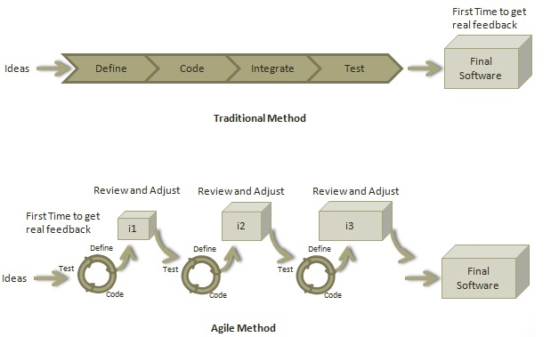
AGILE VS THE TRADITIONAL METHOD

Slide 9
AGILE ROLES
Scrum Master
Enables close cooperation between all roles and functions
Removes any blocks
Shield team from any disturbances
Work with the organization to track progress
Ensure that agile Inspect & Adapt processes are leveraged
Daily stand-ups
Planned meetings
Demos
Reviews
Retrospective Meetings
Facilitate team meetings and decision-making process

Slide 10
AGILE ROLES
Product Owner
Drives the product from the business perspective
Defines the requirements and prioritizes their values
Determines the release date and contents
Takes an active role in iteration planning and release planning meetings
Ensure the team is working on the most valued requirements
Represent the voice of the customer
Accept the user stories that meet the definition of done and defined User Acceptance Criteria

Slide 11
AGILE ROLES
Cross-Functional Development Team
Tech Lead
Senior/most experienced developer
Most knowledgeable of the company’s software/production capabilities
Developers
Those creating the new products
Testers
Creates use cases from User Acceptance Criteria
Tests new features against said use cases
Assures quality
Product Owner
Scrum Master

Slide 12
AGILE-PLANNING
The agile team will work with the customer to capture their stories
A Story is a requirement written so any human could understand it
Basically it provides a simple “Who, What, and Why”
It will read as either of the following:
“As a <User Role> I want <Functionality> so that <Business Value>”
“In order to <Business value> as a <User Role> I want <Functionality>”

Slide 13
AGILE - PLANNING
Once the user stories are gathered, they are scored and prioritized
Scoring
“Points” define how much a team can commit.
The scale used and the team’s capacity is up to the team
Examples:
A point scale based off the relative difficulty of the work, using a modified Fibonacci sequence: 1, 2, 3, 5, 8, 13, 20, 40, 100
Counting the points as an 4 or 8 hour shift of work. I.E. 1 point = 4 hours. 2 points = 8 hours
Prioritizing
MoSCoW
Must have, Should have, Could have, Won’t have

Slide 14
AGILE - PLANNING
Once the stories are scored and prioritized, they are put in the backlog
The most high-priority tickets are then Triaged
Triaging is examining the tickets and writing out the tasks needed to complete them
This gives the dev
The team will then assign out the first few groups of stories into “Sprints”
A Sprint is a development cycle
Usually 2-4 weeks
At the end of each sprint it is expected the team will have produced functional software

Slide 15
AGILE – CONTINUOUS DEVELOPMENT
During each sprint, developers will pick up tickets and complete them
Methods for accomplishing the goal are up to the developer
Once a feature is complete, it is tested
Near the end of the sprint, all finished work is demoed to the customer for final acceptance
Any features which gain acceptance are then packaged for release

Slide 16
AGILE – BENEFITS
Superior quality
Better Control
Reduced time-to-function
Reduced Risks
Turn scope-creep into a benefit
Keeps software relevant
Improved team morale

Slide 17
AGILE - DOWNSIDES
Poor resource planning
Limited Documentation
Fragmented output
No finite end
More customer interaction

